Slide 1

Sickle Cell Support in AZ
AHCCCS/EPSDT supporting Sickle Cell Patient Care

Slide 2
Presenters
Moses Akpan- President & Project Director, Sickle Cell Foundation of Arizona, Inc
  https://www.scfaz.org/
Fran Altmaier- Arizona Department of Health Services, Office of Newborn Screening
  www.aznewborn.com

Slide 3
Objectives
Understand what Sickle Cell disease is
Recognize the importance of the medical home and follow up care
  This includes medical management of Sickle Cell
Identify preventative measures to improve outcomes for persons with Sickle Cell
Learn about the Sickle Cell Foundation of Arizona
  Mission and Vision
  Services available
What to know for AHCCCS members with Sickle Cell

Slide 4
Sickle Cell Facts
Sickle Cell Trait- A person inherits one sickle gene
Sickle Cell Disease – Inheritance of two copies of sickle cell gene one from each parent
Most common genetically inherited disease
One in 12 African Americans have sickle cell trait
0ne in 365 African Americans have sickle cell disease
~100,000 Americans have sickle cell disease
Newborn Screening tests all newborns for sickle cell at birth

Slide 5
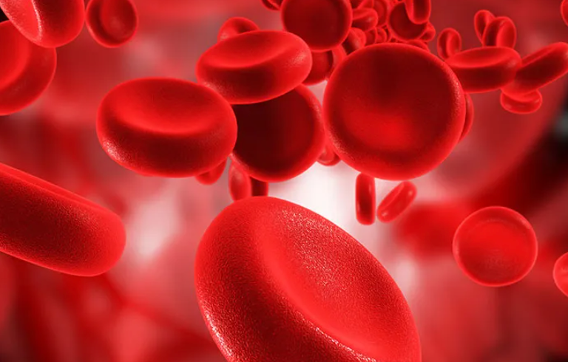
What is Sickle Cell Disease>?
Red Blood Cell disorder causing abnormal hemoglobin
  Hgb is a protein in the blood that carries oxygen throughout the body
Sickle hemoglobin can form stiff rods within the red cells, changing it from a round shape to a crescent or Sickle shape
Cells that are not flexible, can stick to vessel walls, causing blockages that slows or stops the flow of blood
Oxygen cannot reach nearby tissues
  Causing attacks of severe pain (pain crisis) and organ damage

Slide 6
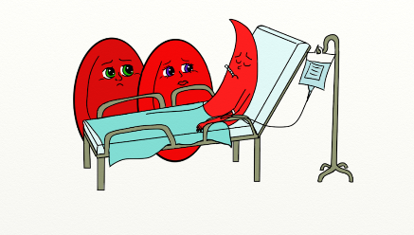
Symptoms and Complications of SCD
Anemia
Pain episodes
Acute chest syndrome
Infections
Stroke
Priapism
Growth failure
Sequestration

Slide 7
Osteomyelitis
Gall stones
Hepatic Sequestration
Anemia
Pain episodes
Acute chest syndrome
Leg Ulcers
Oligospermia
Infections
Stroke
Avascular Necrosis
Acute Multiorgan Failure
Stroke
Growth failure
Sequestration
Retinopathy
Glomerular hypefiltration
albuminuria
Compications with pregnancy

Slide 8
Chronic Pain
Pulmonary Hypertension
Chronic Kidney Disease
Osteomyelitis
Gall stones
Hepatic Sequestration
Anemia
Pain episodes
Acute chest syndrome
Silent Strokes
Neurocognitive Decline
Leg Ulcers
Oligospermia
Infections
Stroke
Red Cell Alloimmunisation
Iron Overload
Avascular Necrosis
Acute Multiorgan Failure
Stroke
Growth failure
Sequestration
Predisposition to Autoimmunity
Sudden Death
Right Heart Failure
LVDD
Retinopathy
Glomerular hypefiltration
albuminuria
Compications with pregnancy

Slide 9
Chronic Multi-organ Failure
Chronic Kidney Disease
Chronic Pain
Pulmonary Hypertension
Osteomyelitis
Gall stones
Hepatic Sequestration
Anemia
Pain episodes
Acute chest syndrome
Silent Strokes
Neurocognitive Decline
Leg Ulcers
Oligospermia
Early Mortality
Infections
Stroke
Red Cell Alloimmunisation
Iron Overload
Avascular Necrosis
Acute Multiorgan Failure
Stroke
Growth failure
Sequestration
Social Catastrophe
Predisposition to Autoimmunity
Sudden Death
Right Heart Failure
LVDD
Retinopathy
Glomerular hypefiltration
albuminuria
Compications with pregnancy

Slide 10

Sickle Cell Patient Care
Ensure children are having their EPSDT routine well visits- Promote use of medical home
Follow up with Hematologists as prescribed
Medication management
  Penicillin
  Hydroxyurea
Immunizations
Monitor ER visits and hospital admissions
Refer families to SCFAZ for community health worker support and resources
Help eliminate misinformation and stigma about the disease
Help reduce the number of patients who are lost to follow up

Slide 11
Sickle Cell Foundation of Arizona
Seeks out, promotes, provides and creates opportunities for those afflicted with Sickle Cell Disease (SCD) to gain access to available resources
The foundation supports education, research, identification, prevention, treatment and cure of SCD and provision of services and supports to individuals and their families living with SCD
Aspires to be a positive influence, resource and voice of inspiration to individuals with SCD and their families.
Partner with public, private, educational, medical and other SCD organizations to achieve its goals.

Slide 12
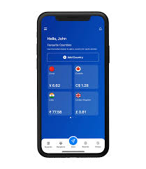
Force for Health- Application development
A FREE APP FOR THE PATIENTS, FAMILIES, & EXTENDED COMMUNITY, BUILT FOR BOTH THE CLINICAL & NON-CLINICAL SPACE
ONLINE TRACKERS, EDUCATION, RESOURCES, COMMUNITIES & SUPPORT FOR FAMILIES IN ARIZONA LIVING WITH SICKLE CELL ANEMIA
Anticipated to go live on Apple and Google Play Stores (on or around 10/17/23)

Slide 13

For More information about SCFAZ and NBS
Sickle Cell Foundation of Arizona (SCFAZ)
Phone: 888-211-5112
  Community Health Worker- Phx: EXT 803
  Community Health Worker-Tucson: EXT 804
Email: info@scfaz.org
www.scfaz.org
ADHS- Office of Newborn Screening
Phone: 602-364-1409
NBSfollowup@azdhs.gov
Education@azdhs.gov
www.aznewborn.com

